Slide 1
EAST Master Class Series Live Webinar #2: REBOA
Laura Moore, MD, FACS
and
Elizabeth Benjamin, MD, PhD, FACS
Brought to you by the EAST Online Education Section

Slide 2
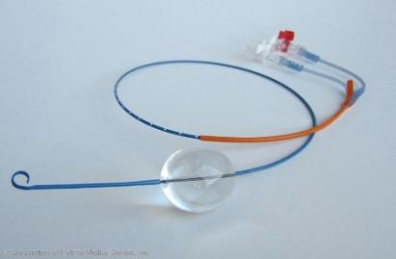
Generously sponsored by an unrestricted educational grant

Slide 3
Start Recording

Slide 4
REBOA Techniques, Indications, Pitfalls and Incorporating it in to your Trauma Program
Laura J. Moore, MD, FACS
Associate Professor of Surgery
Chief of Surgical Critical Care
Medical Director, Shock Trauma ICU
Elizabeth Benjamin MD, PhD, FACS
Assistant Professor of Clinical Surgery
LAC+USC Medical Center
Notes:
Want to put your institution?

Slide 5
Introduction
Hemorrhage remains a leading cause of death in civilian and wartime trauma
Hemorrhage occurs in two broad categories:
Compressible
Non compressible
Vascular disruption with concomitant hemorrhage is the leading cause of potentially preventable death in trauma patients

Slide 6
OBJECTIVES
Overview of REBOA
Clinical indications
Zones of Occlusion
Technical Considerations
14 Fr and 7 Fr systems
Potential Pitfalls
Educational opportunities
How to implement REBOA at your center

Slide 7
Statement of the Problem
Hemodynamically unstable trauma patients with hemorrhage from the abdomen and pelvis have a high mortality rates.
Failure to rapidly treat hemorrhage results in cardiovascular collapse and death.

Slide 8
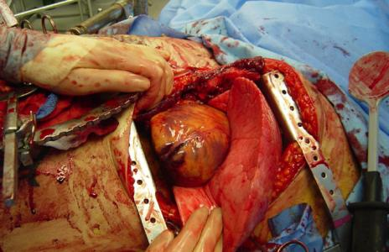
Options for Aortic Occlusion
1. Resuscitative thoracotomy with application of aortic cross clamp.

Slide 9
Options for Aortic Occlusion
Resuscitative thoracotomy with application of aortic cross clamp.
Insertion of catheter into the aorta with inflation of a balloon to occlude lumen of the aorta.

Slide 10
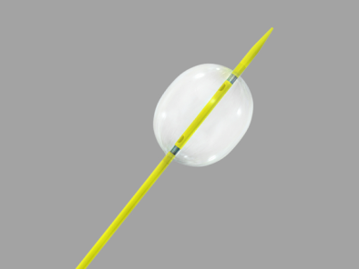
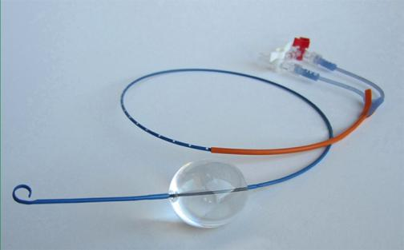
What is REBOA?
Resuscitative
Endovascular
Balloon
Occlusion of the
Aorta

Slide 11
Similarities and Differences
Resuscitative Thoracotomy | REBOA
Maximally Invasive | Minimally Invasive
High potential for blood exposure via accidental puncture to healthcare team | Lower risk for blood exposure via accidental puncture to healthcare team
Aortic Occlusion via Cross clamping | Aortic Occlusion via Endovascular Balloon
Supports myocardial and cerebral perfusion | Supports myocardial and cerebral perfusion
Allows access to other mediastinal structures (pericardium, heart, hilum) | Allows for selective occlusion (Zone I vs. Zone III)

Slide 12
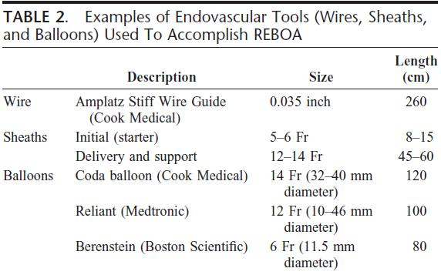
How
1. Arterial access
s
2. Balloon selection & positioning
3. Balloon inflation
4. Balloon deflation
5. Sheath removal

Slide 13
Aortic Occlusion Zones
Zone I – Descending thoracic aorta from origin of left subclavian to celiac
Zones II – Paravisceral aorta between celiac and lowest renal artery
Zone III – Infrarenal abdominal aorta to bifurcation

Slide 14
Aortic Occlusion Zones
Select zone of occlusion based upon injury pattern
Zones I and III preferred
Avoid occlusion in Zone II
Confirm zone of occlusion on plain x ray or fluoroscopy

Slide 15
REBOA Algorithm

Slide 16
REBOA - Patient Selection
Refractory hemorrhagic shock due to non-compressible truncal hemorrhage
Penetrating abdominal trauma
Blunt trauma

Slide 17
REBOA - Patient Selection
Refractory hemorrhagic shock due to non-compressible truncal hemorrhage
Penetrating abdominal trauma
Blunt trauma
Resuscitative thoracotomy should still remain standard for patients with cardiovascular collapse from intra-thoracic hemorrhage

Slide 18
Case Example
24 year old male sustained a gunshot wound to the right upper quadrant. On arrival in the ER he was in extremis with a systolic blood pressure of 50 mm Hg and a heart rate of 135. Two large bore peripheral IVs were in place. Abdominal FAST exam was positive. Massive transfusion protocol was initiated. The OR was notified.

Slide 19
KUB in ER

Slide 20
Case continued
The patient remained hypotensive with a systolic blood pressure in the 50’s. Given his positive abdominal FAST the decision was made to place a REBOA in Zone 1. The right common femoral artery was accessed percutaneously and a 14 French sheath was placed. The CODA catheter was inserted and the balloon was inflated in Zone 1.

Slide 21
Zone 1 REBOA

Slide 22
Operative Details
Massive hemoperitoneum
Grade V right renal injury with active arterial hemorrhage from the hilum -> right nephrectomy performed
Bullet lodged in the vertebral body with ongoing hemorrhage -> patient underwent angioembolization of lumbar artery
Right groin cutdown performed, sheath removed, common femoral artery repaired

Slide 23
Hospital Course
Admitted to STICU post op
Taken back in 24 hours for abdominal closure
Discharged to rehab facility on post operative day 12

Slide 24
Zone 3 REBOA

Slide 25
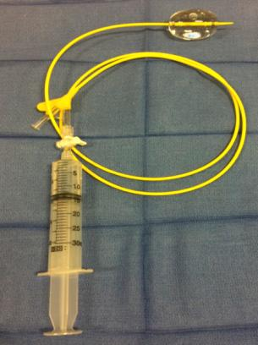
REBOA Placement Technique
14F System
7F System

Slide 26
REBOA Technique
14F System
7F System
Femoral Arterial Access
7F Sheath Placement
Wire exchange
Wireless
Upsize sheath 14F
Float REBOA

Slide 27
14F System
Arterial Access
Sheath
Introducer
Measure Catheter
Stiff Wire
Upsize Sheath
REBOA Insertion
Inflate Balloon

Slide 28
14F System
Arterial Access
Sheath
Introducer
Measure Catheter
Stiff Wire
Upsize Sheath
REBOA Insertion
Inflate Balloon

Slide 29
14F System
Arterial Access
Sheath
Introducer
Measure Catheter
Stiff Wire
Upsize Sheath
REBOA Insertion
Inflate Balloon

Slide 30
14F System
Arterial Access
Sheath
Introducer
Measure Catheter
Stiff Wire
Upsize Sheath
REBOA Insertion
Inflate Balloon

Slide 31
14F System
Arterial Access
Sheath
Introducer
Measure Catheter
Stiff Wire
Upsize Sheath
REBOA Insertion
Inflate Balloon

Slide 32
14F System
Arterial Access
Sheath
Introducer
Measure Catheter
Stiff Wire
Upsize Sheath
REBOA Insertion
Inflate Balloon

Slide 33
14F System
Arterial Access
Sheath
Introducer
Measure Catheter
Stiff Wire
Upsize Sheath
REBOA Insertion
Inflate Balloon

Slide 34
14F System
Arterial Access
Sheath
Introducer
Measure Catheter
Stiff Wire
Upsize Sheath
REBOA Insertion
Inflate Balloon

Slide 35
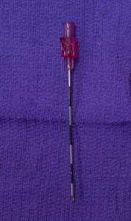
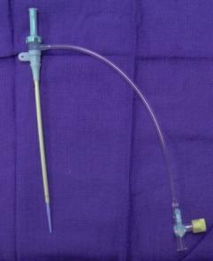
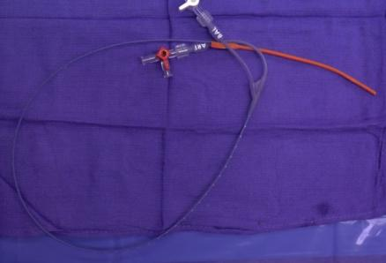
7F System
Arterial Access
7F Sheath Placement
Wireless Catheter Insertion

Slide 36
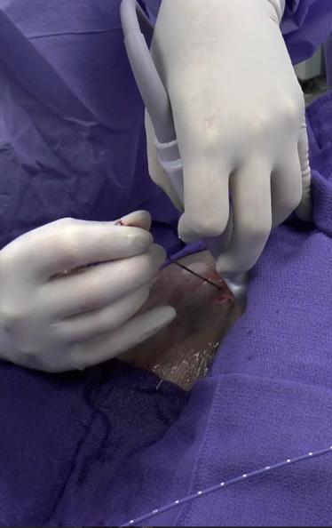
7F System
Arterial Access
Sheath
Introducer
Measure Catheter
Stiff Wire
Upsize Sheath
REBOA Insertion
Inflate Balloon

Slide 37
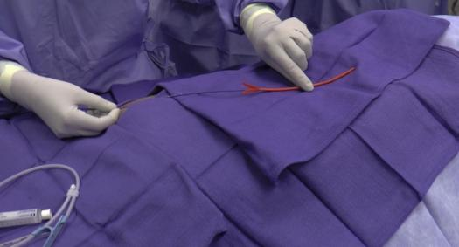
7F System
Arterial Access
Sheath
Introducer
Measure Catheter
Stiff Wire
Upsize Sheath
REBOA Insertion
Inflate Balloon

Slide 38
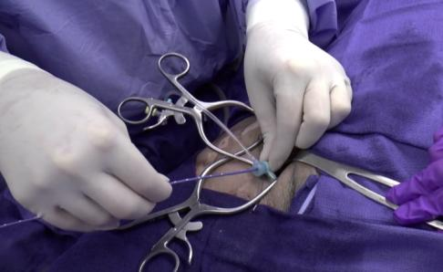
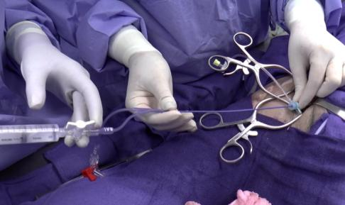
7F System
Arterial Access
Sheath
Introducer
Measure Catheter
Stiff Wire
Upsize Sheath
REBOA Insertion
Inflate Balloon

Slide 39
Catheter Measurement
External landmarks
X-ray verification
Fluoroscopy

Slide 40
Catheter Measurement
External landmarks
X-ray verification
Fluoroscopy
Cadaver based study
Mid-Sternum as external landmark
100% Balloon deployed in landing zone (I)

Slide 41
LAC+USC REBOA Patient Selection
Refractory hemorrhagic shock
Failed aggressive ED resuscitation
Anticipated operative intervention
Anticipated occlusion time <30min
Liberal thoracotomy for cardiac arrest

Slide 42
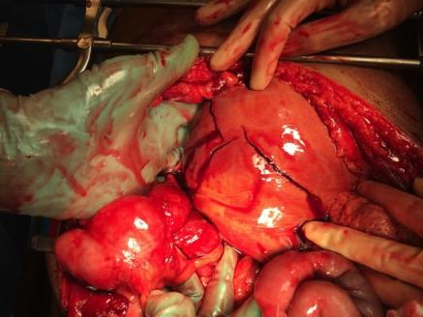
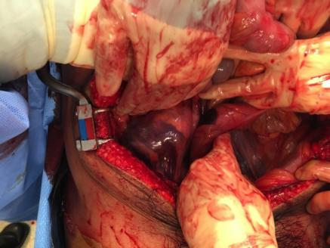
REBOA Patient Selection Significant Intra-Abdominal Injury Burden

Slide 43
Ongoing Resuscitation
Extremity Trauma
Tourniquet
Abdominal Trauma
REBOA
Thoracic Trauma
Thoracotomy
Cardiac Arrest
Thoracotomy

Slide 44
Ongoing Resuscitation
Extremity Trauma
Tourniquet
Abdominal Trauma
REBOA
Hypotension refractory to resuscitation
Temporary maneuver
Imminent operative intervention
Delay hypovolemic cardiac arrest
Thoracic Trauma
Thoracotomy
Cardiac Arrest
Thoracotomy

Slide 45
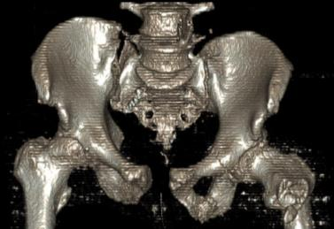
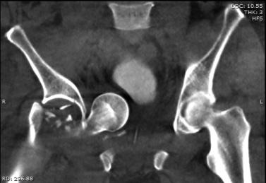
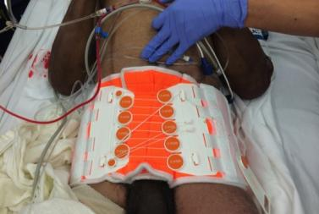
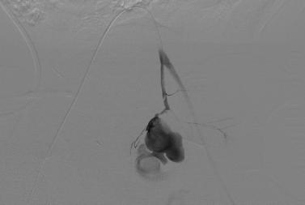
Pelvic Bleeding Candidate for Zone 3 Occlusion

Slide 46
Severe Pelvic Fracture (PXR)
Hypotension
Resuscitation
Refractory Hypotension
Volume
Responsive
+/- REBOA
Interventional Radiology
Operating Room

Slide 47
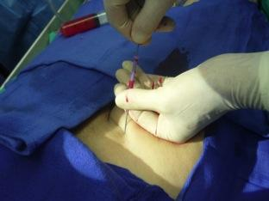
REBOA Indication Summary
Hemodynamic Instability
Abdominal or Pelvic Trauma
Bridge to operative intervention
Not used in cardiac arrest

Slide 48
REBOA Program: Key Elements
Identify hospital resources
Interventions/Complications
Clear understanding of patient selection
Surgeon driven
Training program
Initial training
Skill maintenance
Patient Safety/Quality Improvement

Slide 49
REBOA Training
Centralized Training
Standardized approach
Certificate upon completion
Hospital credentialing
Internal Institution-Specific Training
Training tailored to specific needs of participants and hospital resources
Availability of refresher training

Slide 50
REBOA Training LAC+USC
Didactic Sessions
Literature review
Procedure indications
Potential pitfalls
Catheter System Familiarity
Perfused Cadaver Sessions
Case Analysis

Slide 51
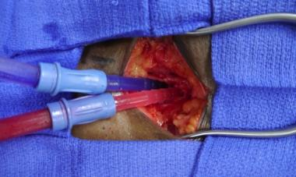
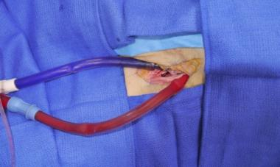
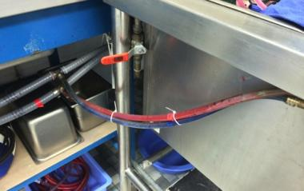
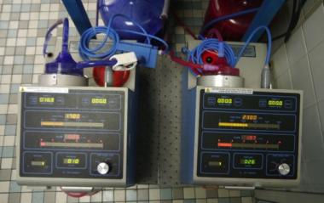
REBOA Training LAC+USC FTDL
Arterial and Venous Perfusion
Perfusion Pump and Drainage

Slide 52
CODA Placement: 14F catheter

Slide 53
ER REBOA: 7 Fr Catheter

Slide 54
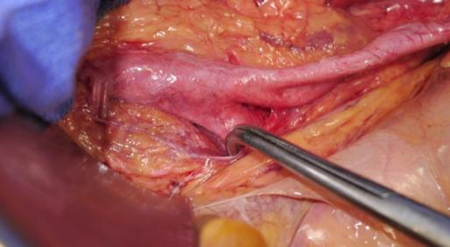
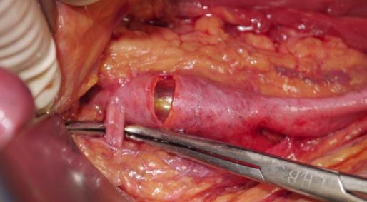
Zone 3 Positioning

Slide 55
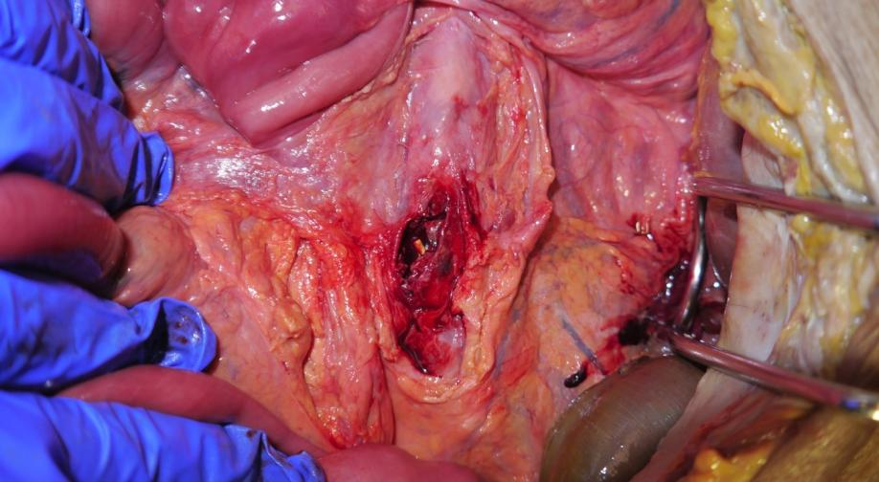
Distal Aortic Disruption

Slide 56
Hemodynamic Response

Slide 57
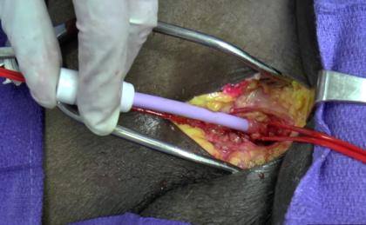
Potential Pitfalls
Catheter Placement
Patient selection
No benefit to patient
Delay in treatment
Zone 2 inflation
Intestinal ischemia
Vascular injury
Arterial dissection/transection
Thrombosis

Slide 58
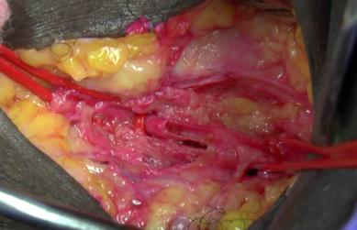
Potential Pitfalls
Catheter Removal
Hematoma
Complicated arterial repair
Arterial dissection or thrombosis
Embolic event
Limb loss

Slide 59
Complications: Sheath Removal

Slide 60
Series of 24 REBOA cases from Japan (single center, over 6 years)
Reported 3 lower extremity amputations from REBOA insertion
10 French Sheath used
Procedure performed by ER doctors or Surgeons
SHOULD WE ABANDON REBOA???

Slide 61
Presented at 2016 MHSRS
Purpose:
Evaluate vascular related complications related to REBOA insertion at the Texas Trauma Institute
Methods:
Retrospective review
Operative details, outcomes
*14 Fr Sheath & CODA balloon used in all cases

Slide 62
RESULTS
Total number of patients | 33
Median Age | 47 (IQR 26.5-62.5)
% male | 79
% blunt mechanism | 88
% percutaneous access of CFA | 55

Slide 63
VASCULAR COMPLICATIONS
No amputations attributed to REBOA
21 of 33 patients survived to sheath removal
13 (62%) underwent primary repair of CFA
8 patients required additional vascular interventions
3 thrombectomy alone
2 thrombectomy + repair of dissection flaps + patch angioplasty
1 thrombectomy + patch angioplasty
1 thrombectomy + interposition graft + prophylactic fasciotomy
1 thrombectomy + repair of dissection flap

Slide 64
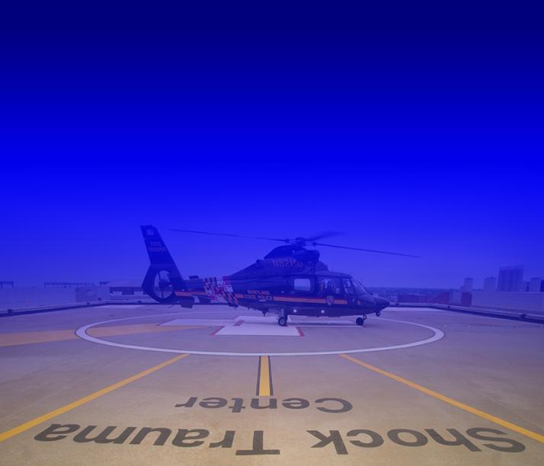
Basic Endovascular
Skills for Trauma

Slide 65
BEST Course
Currently offered in Baltimore and Houston
ACS verified course
For more information about BEST contact:
Baltimore: BEST@umm.edu
Houston: laura.j.moore@uth.tmc.edu

Slide 66
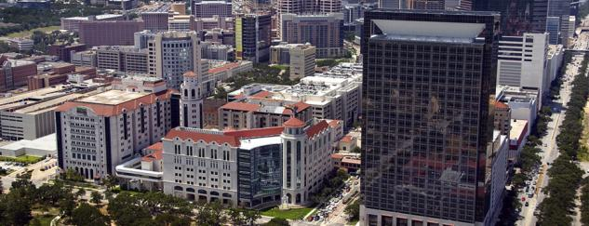
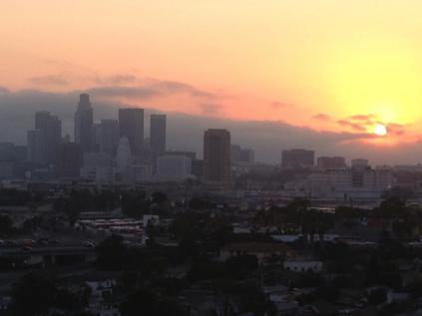
Questions?
laura.j.moore@uth.tmc.edu
Elizabeth.Benjamin@med.usc.edu

Slide 67
www.prytimemedical.com
Customer Service: 210-340-0116
David Spencer – President/CEO
Roger Baker – SVP, Global Sales & Marketing

